Slide 1
Academic Peer Instruction (API)
Hafsa Tahir, SSM
Rahina Yeasmeen SSM
Shofiyaa Abdul, SSM

Slide 2
What is the API program about?
Academic Peer Instruction (API) is a peer tutoring program that is modeled after a nationally recognized program, called Supplemental Instruction (SI).
In API, once a "high risk" course has been selected, an API student leader is hired. Ex. Math, Economics, Chemistry, Physics, Accounting etc.
Recently API program received greater funding, which has allowed them to offer tutoring to students in remedial courses.
The main goal of the program is to provide professional tutors to the students who can help overcome the barriers to achieve academic goals.

Slide 5
Are you interested in being an API tutor?
Eligibility:
Be a current LaGuardia student, with a 3.0 GPA or above
Completed a "high risk" or difficult course and received a grade of B+ or above.
Can devote about 12 hours a week of your time to help others.
Recommendation from 2 faculty members
You can gain:
Leadership skills
Strengthen knowledge in the subject he/she is tutoring
Enjoy the good feeling of having helped other students improve their grades
Join a community of other excellent students - API leaders
Gain valuable teaching/tutoring experience and strengthen own self-confidence - many of other leaders have successfully transferred to top colleges thanks to their role as API leaders.
Be paid for the efforts.

Slide 6
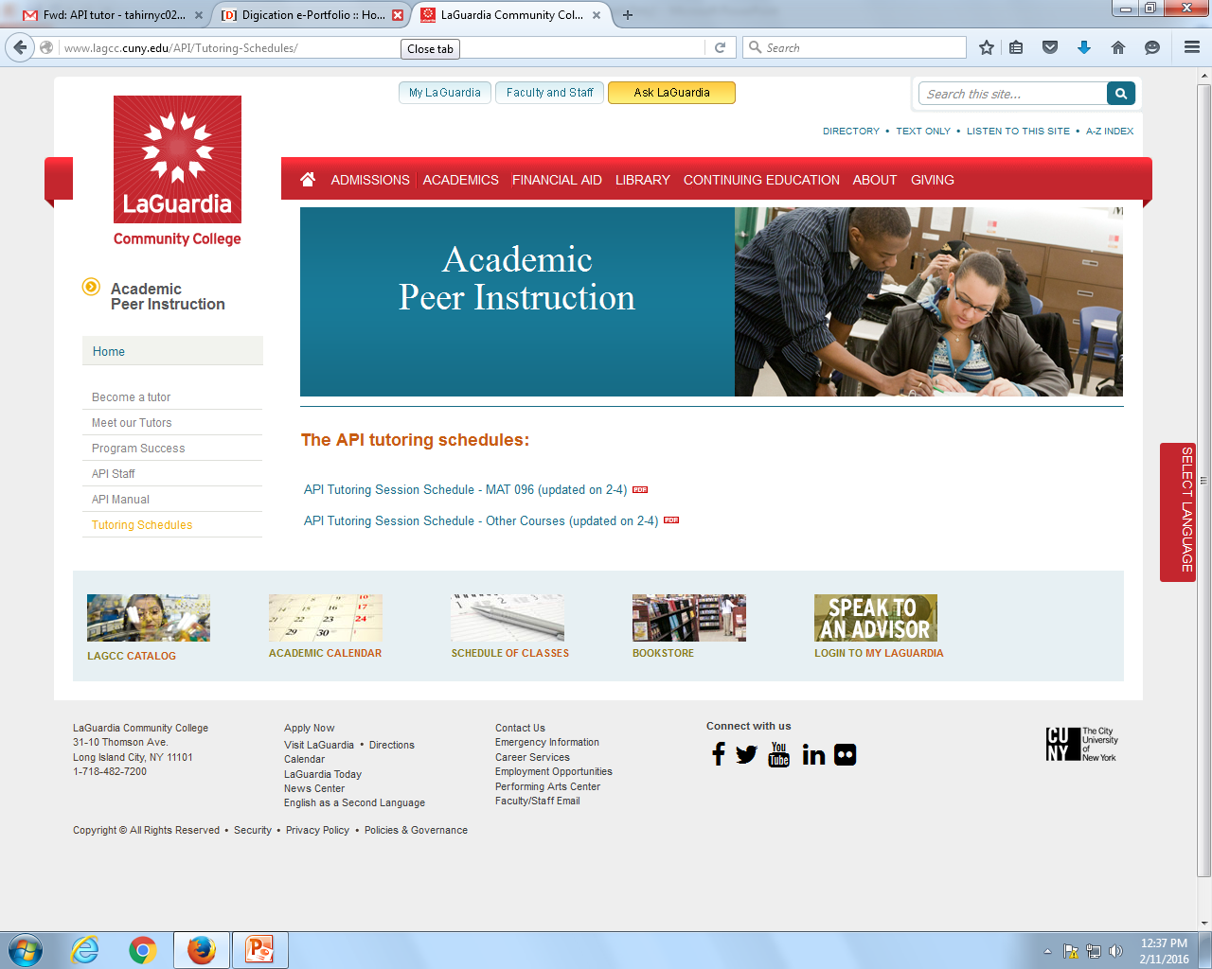
Schedule
Each API tutor is assigned to a particular course section.
The tutor can work with any students from the same course
Students can check the schedule from the API office located in E 115 Q or by visiting the website. http://www.lagcc.cuny.edu/API/

Slide 7
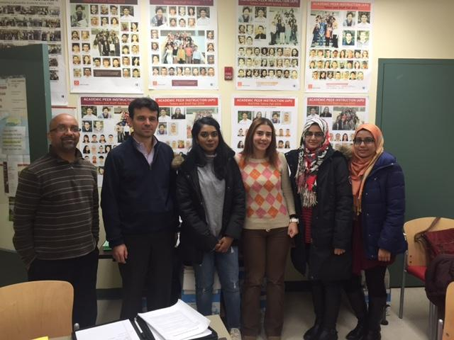

Slide 8
Contact Information
Download an application at http://www.lagcc.cuny.edu/API/
API Phone : (718) 482 - 5215
API Office - E115Q
Point persons:
Dr. Andi Toce – Coordinator
Dr. Reem Jaafar - Coordinator
Daryl Davis - Administrative Coordinator
Dr. Joyce Zaritsky - Advisor

Slide 9
Acknowledgements
The information in this presentation was obtained from a brief interview with Prof. Reem Jafaar and Andi Toce from the API tutor office for students and faculty in the FYS.

